Slide 1

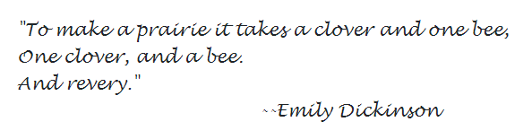




The Bank Where Service Never Ends

Slide 2
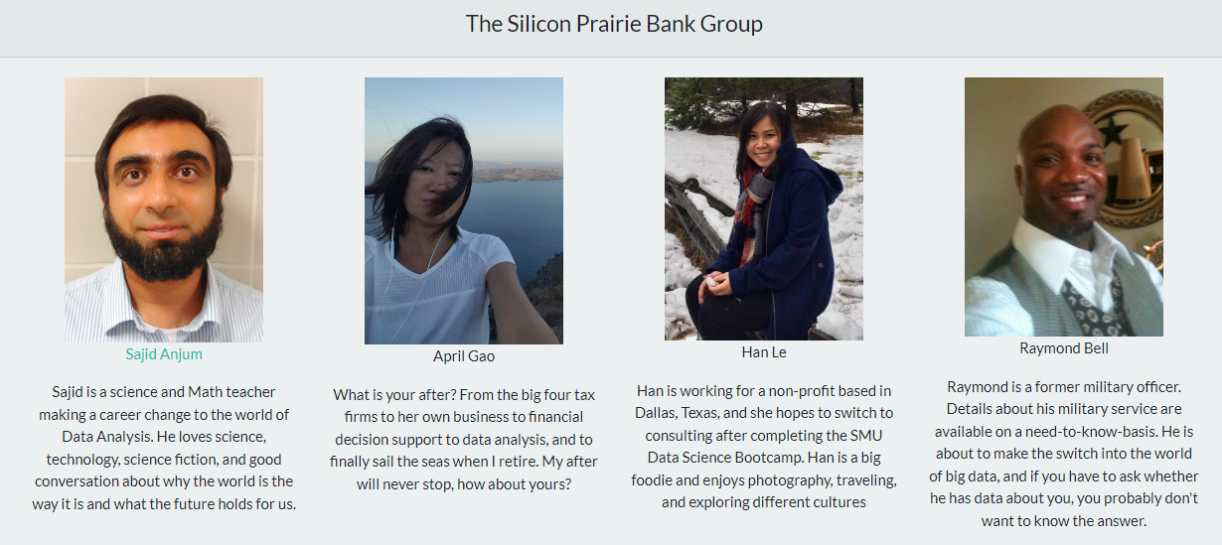

Slide 3
Introduction

Slide 4
Twentieth Century Banking
Prior to the advent of modern banking, loans were only accessible to a select and connected elite.
The development of the Federal Reserve, ATMs, credit cards, and internet banking has allowed banking and financial services to be accessible to the majority of the American population
Stability without centralization is the goal of a dynamic and prosperous financial system, and this is only possible if banks can make good decisions that minimize risk.

Slide 5
We created two machine learning models and a web app to deploy them
How Can We Make Banking Better?
The first model helps us to predict whether an applicant will default on their credit card
The second model helps banks to predict whether an applicant will default on their personal loan.
We hope that helping banks make better decisions will allow them to customize credit cards and loans for every single applicant.

Slide 6
Data Processing and Machine Learning

Slide 7
Data Sets
We obtained both of our datasets from Kaggle
Our credit card data set was a dataset of customers in China who had applied for a credit card
The dataset was very clean with no null values, binary columns already encoded as 0s and 1s, and numerical columns in appropriate datatypes.
We dropped columns that referenced whether the applicant had a phone, work phone, or email address, as we did not think those columns would have predictive power.

Slide 8
Preparation of Data
Binary Columns
Numerical Columns
Categorical Columns
'Gender' 'Own_car' 'Own_property' 'Unemployed'
'Num_children'
'Num_family’, 'Account_length' 'Total_income’ 'Age’ 'Years_employed'
'Income_type’ 'Education_type’ 'Family_status’ 'Housing_type' 'Occupation_type'
Label encoding
One-Hot Encoding
No Change

Slide 9
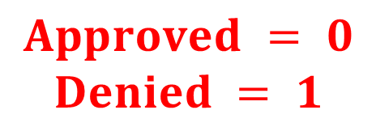
Preparation of Data
Target Column:
Approved or Denied
Binary encoded
$$Approved = 0$$
$$Denied = 1$$
Our final dataset had fifty columns excluding the Target.
We felt that classification machine learning algorithms would be best for this sort of data set

Slide 10


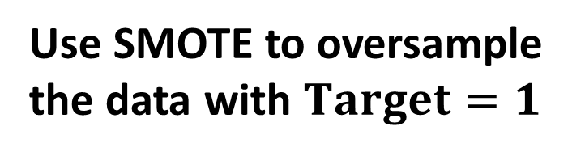
Preparation of Data
Use SMOTE to oversample the data with $Target=1$
Imbalance
Balance

Slide 11
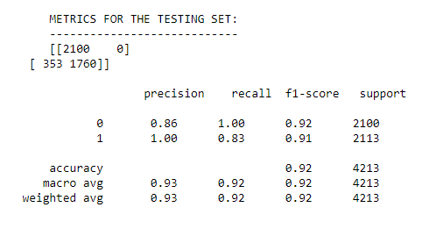
Machine Learning
A Tree model (LGBMClassifer) worked best
The model was able to identify every single default
The recall was 0.83, which means that for every 5 loans the model correctly identified as a default, one good customer was incorrectly predicted to default.

Slide 12
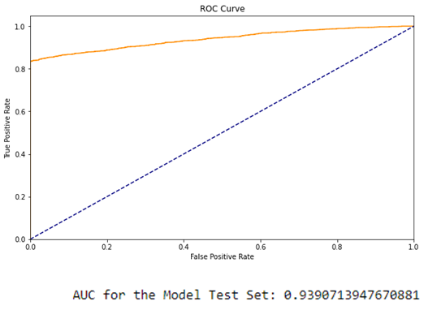
Machine Learning
The AUC for the ROC curve was about 94%.
We conclude that the model will be great at identifying defaults, although perhaps overpredicting defaulters just a tad.

Slide 13
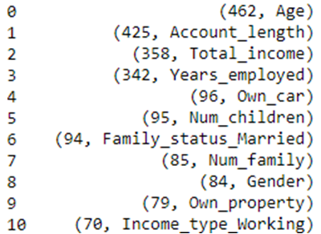
Machine Learning (Explainability)
The most important features of our model were:
We decided to see how the probability of our model predictions varied versus a variation in these features.
We created a fake “average” customer and varied these features.

Slide 14
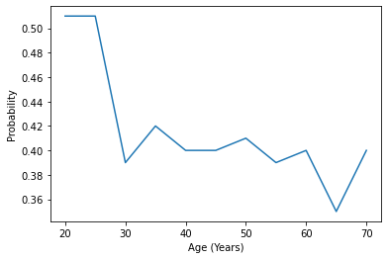
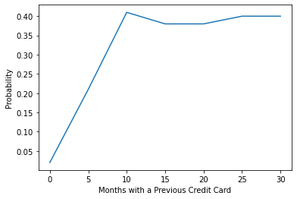
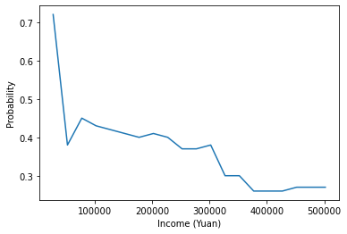
Machine Learning (Explainability)

Slide 15
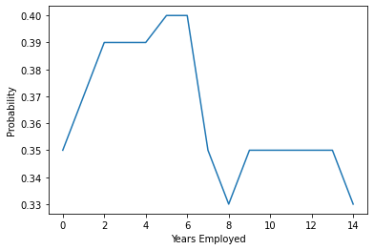
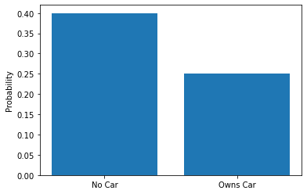
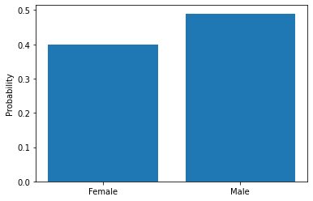
Machine Learning (Explainability)

Slide 16
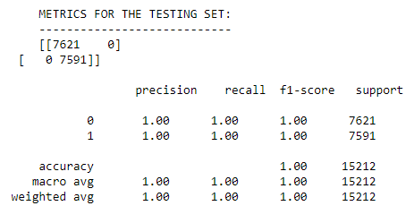
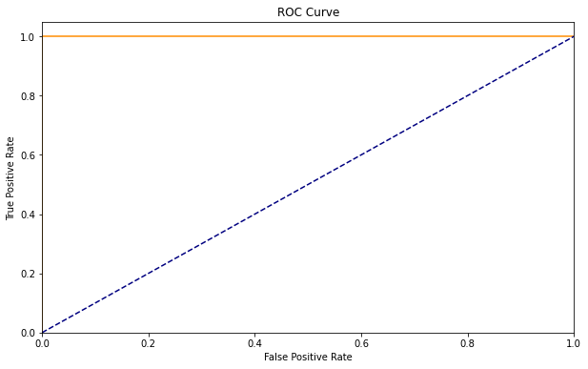
Machine Learning
We used a RandomForestClassifier to create a model for our loan dataset. The details are in our writeup. Unfortunately, we were not able to deploy the model on our website.
This is a shame as the model was perfect!

Slide 17
Website

Slide 18
Conclusions

Slide 19
Limitations and Future Work

Slide 20
Acknowledgments

